Slide 1


Figures in R
James Marcaccio

Slide 2
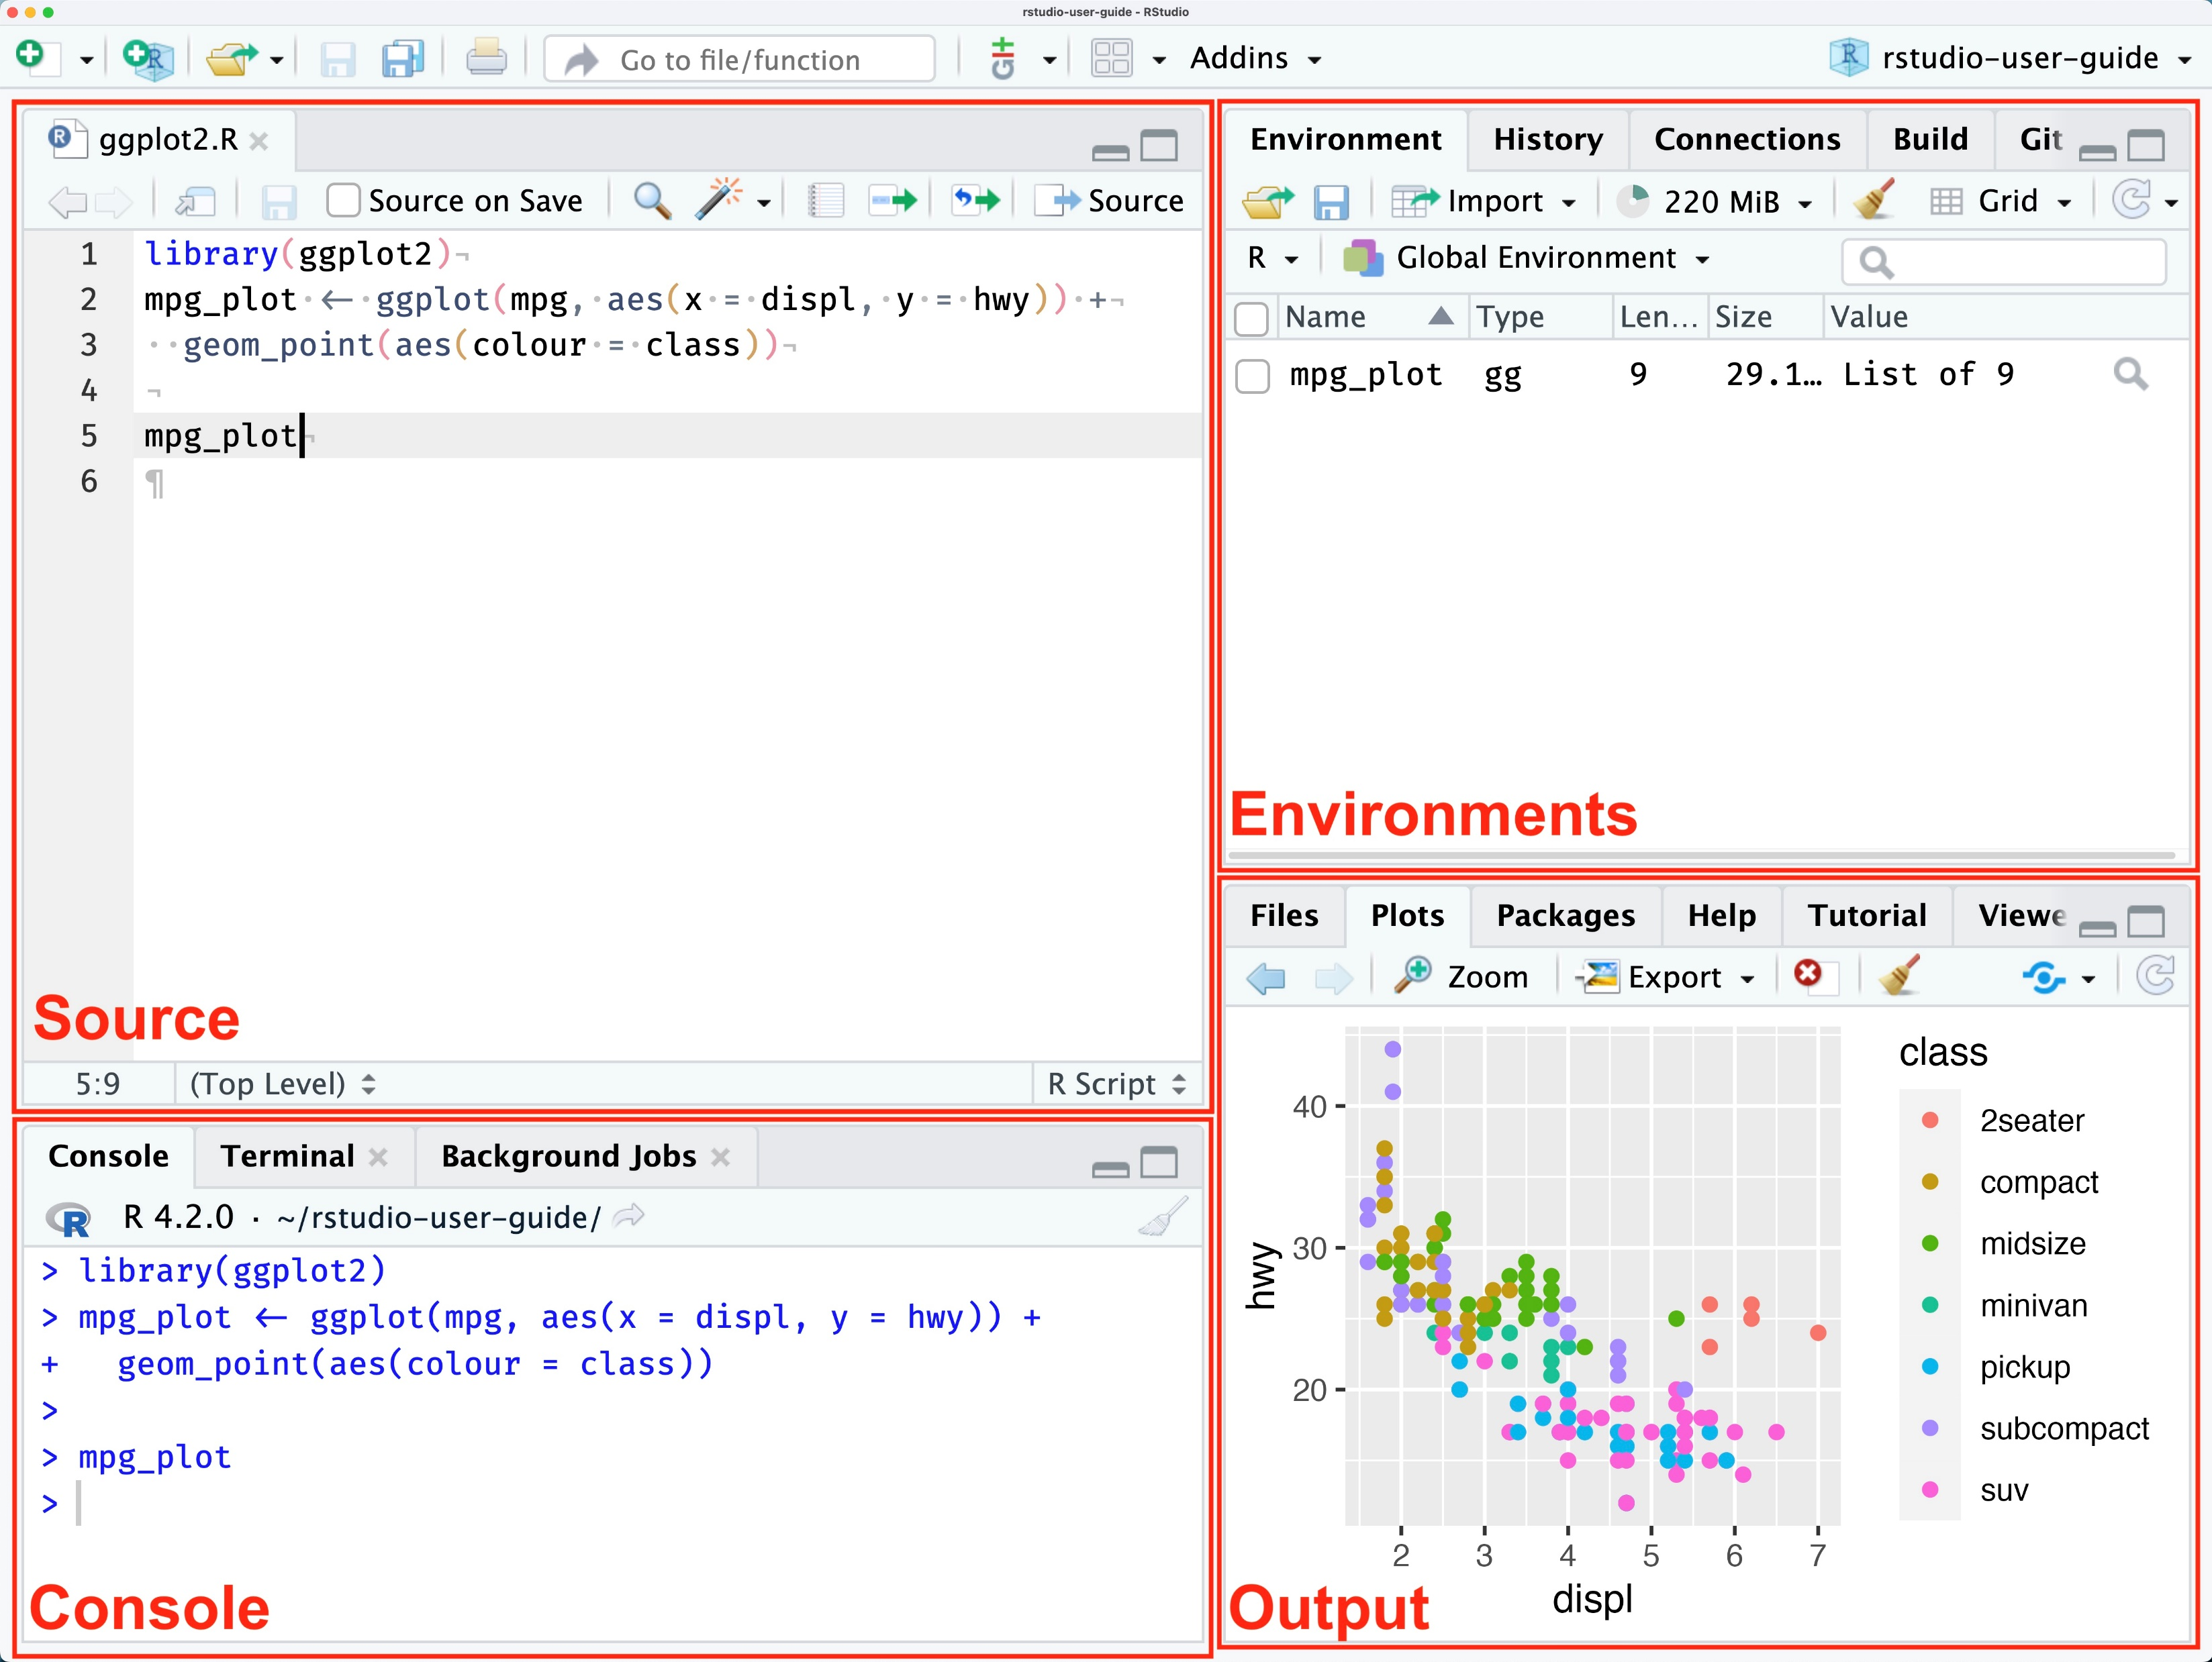
Source: docs.posit.co
RStudio User Guide 2024.12.0

Slide 3
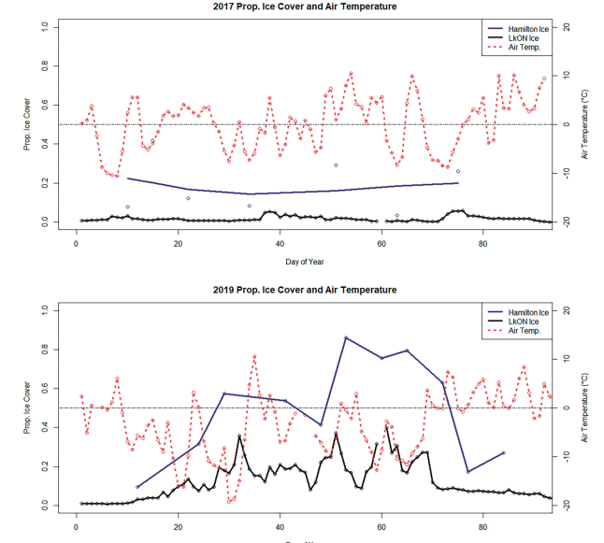
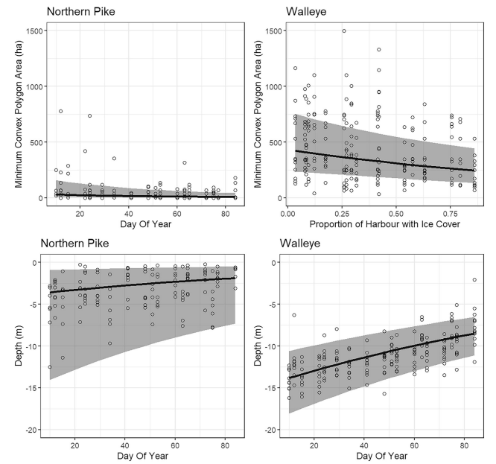
Before we make figures…
Check your input data
Does it make sense?
Is it in order?
Check your working directory
setwd()
Ask: why are we making this figure?
Exploring? Plotting? Visualizing?
The Data Visualisation Catalogue
Marcaccio et al. 2022. DOI: 10.1080/07038992.2021.1946385

Slide 4
‘Why’ can inform how we make what
Exploring: what data are available?
First glance
Plotting: how are the data structured?
E.g. Trends, normality
Visualizing: a final output for publication
Ensure all details are accessible
Marcaccio et al. 2022. DOI: 10.1080/07038992.2021.1946385

Slide 5

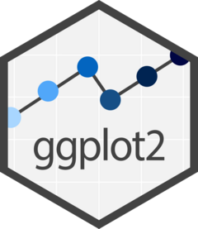
What is ggplot2?
‘The grammar of graphics’
Not a base function in R
install.packages(“ggplot2”)
library(ggplot2)

Slide 6
ggplot2
The way ggplot works:
ggplot(data, aes(x,y)) + geom_*()
Data: your data input
aes: some aesthetic specification
geom_*: the plot type
ggplot(data = mtcars,
aes(x = wt, y = mpg)) +
geom_point() +
facet_wrap(~cyl) +
theme_minimal()

Slide 7
ggplot2
The way ggplot works:
ggplot(data, aes(x,y)) + geom_*()
Facets: split plot into subplots
Themes: non-data display elements (e.g. background)
ggplot(data = mtcars,
aes(x = wt, y = mpg)) +
geom_point() +
facet_wrap(~cyl) +
theme_minimal()

Slide 8
ggplot plot types
Geom_point()
Geom_line()
Geom_bar()
Geom_boxplot()

Slide 9
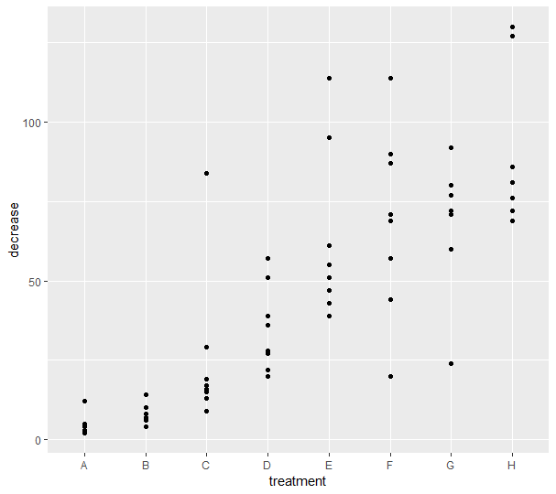
Basic scatter plot

Slide 10
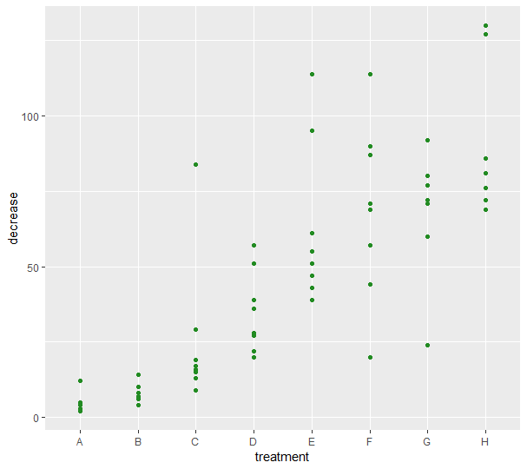
Adding a colour to your points

Slide 11
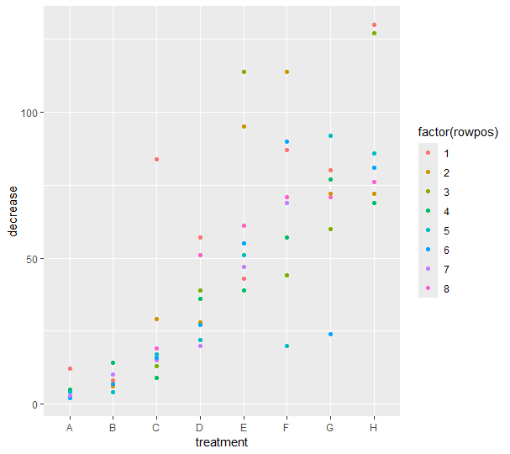
Changing colour based on a variable

Slide 12
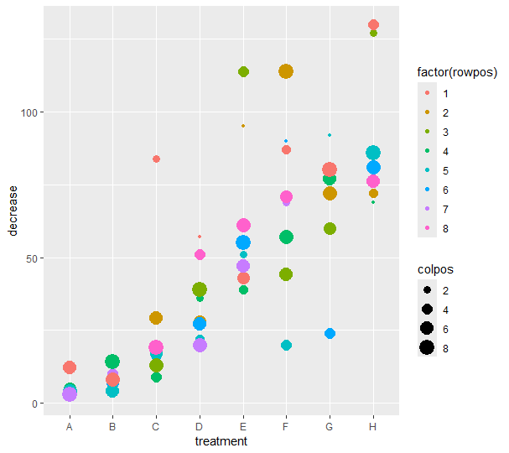
Changing colour and size based on variables

Slide 13
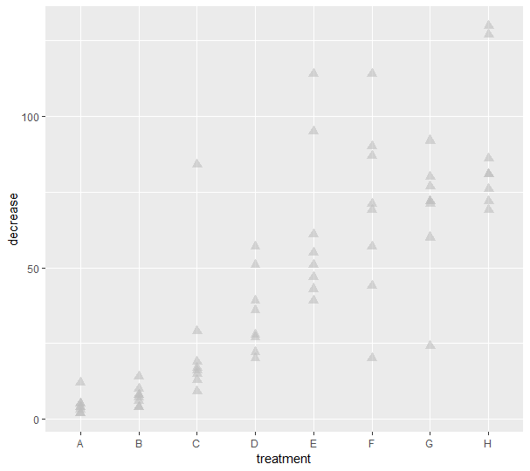
Changing shape and transparency

Slide 14

Using ‘jitter’ to stop points overlapping

Slide 15
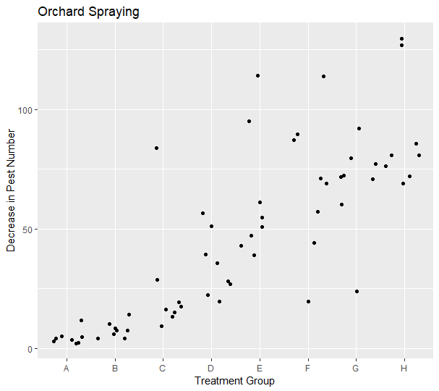
Label your figure and axes

Slide 16
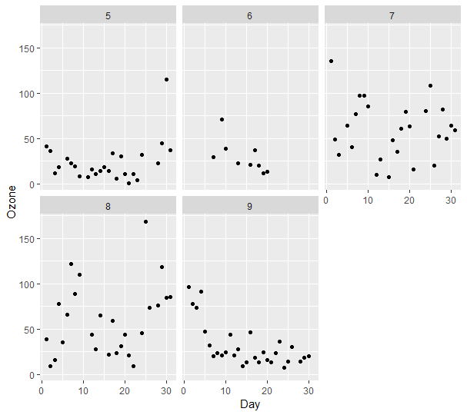
Multi-panel plot (by month)

Slide 17
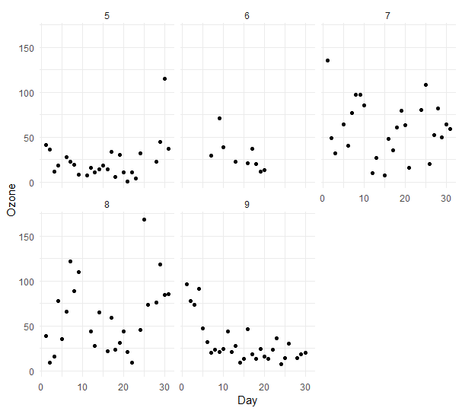
Using a ‘minimal’ theme for white background

Slide 18
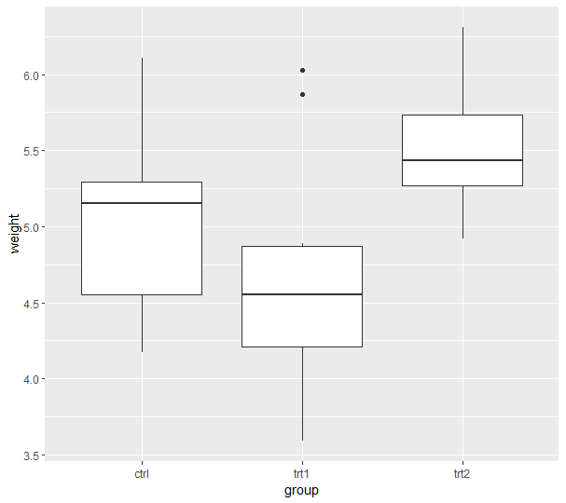
Boxplots

Slide 19
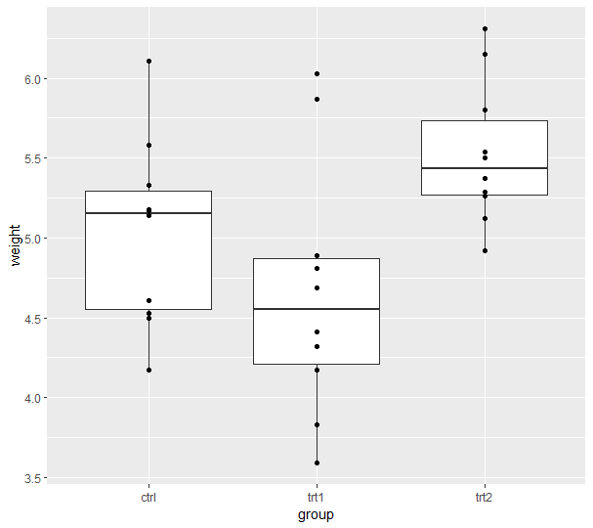
Boxplots with all data values

Slide 20
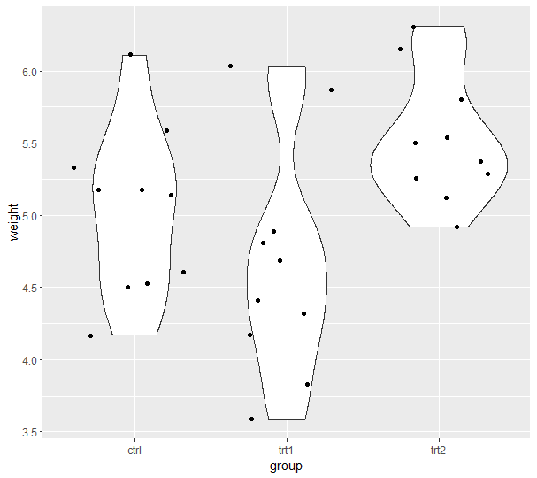
Violin plots with data points

Slide 21
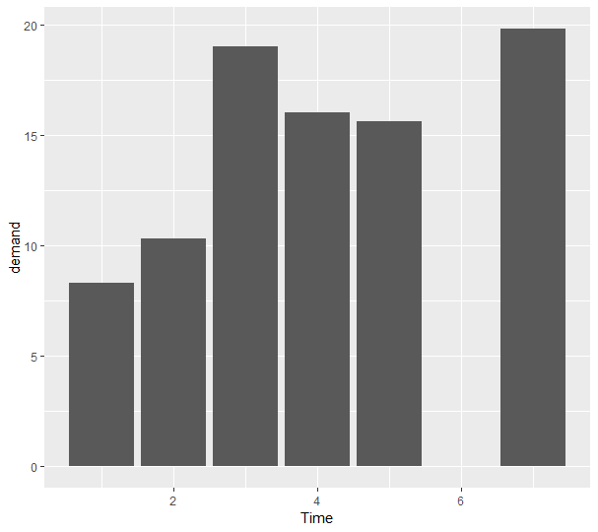
Bar charts in ggplot

Slide 22
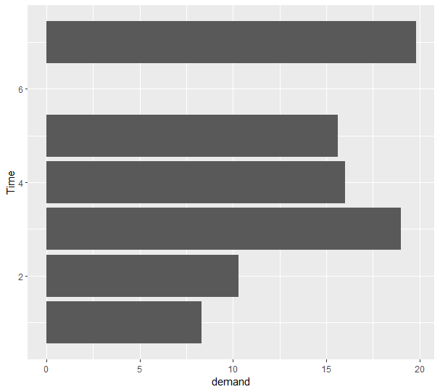
Flipping charts with coord_flip()

Slide 23
Please take care ahead!
Use a specific function or analysis to model/fit your data
Know your data & have a plan of analyses
There are other packages that are better for mapping

Slide 24
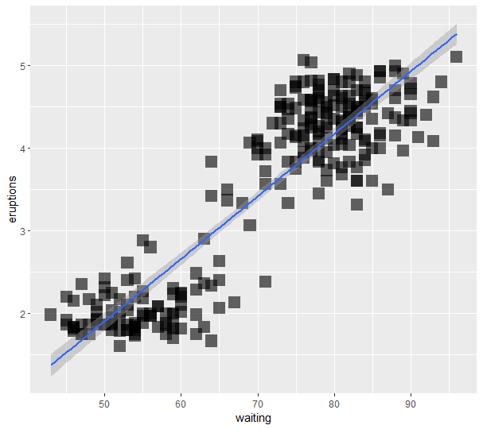
Fitting a (linear) smoothed line to data

Slide 25
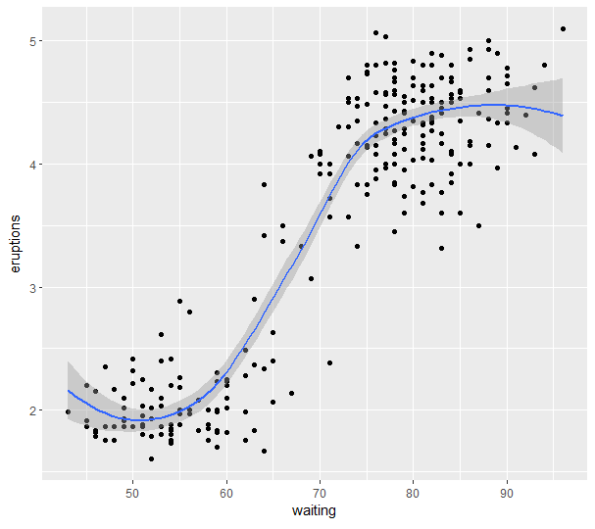
Fitting a smoothed line to data

Slide 26
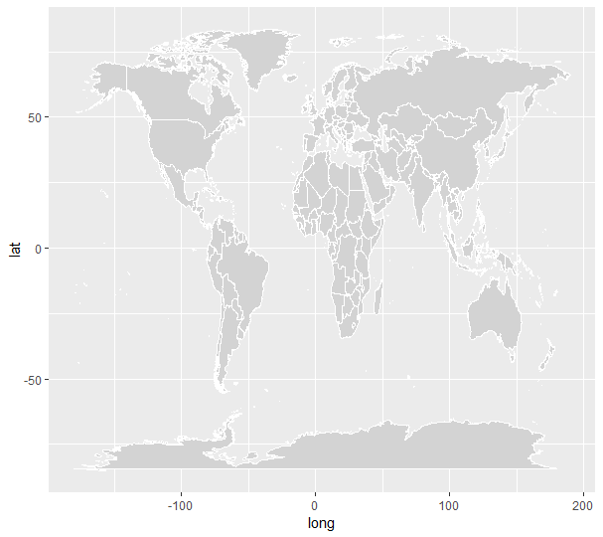
Generating a map in ggplot

Slide 27
Thanks for your attention!
ggplot2 cheat sheet:
data-visualization
MaDGIC is here to assist! Contact us in Bata Library 402 or schedule an appoint: https://www.trentu.ca/library/maps-data-government-information-centre/contact-us

